Slide 1

ROUTINE HEALTH INFORMATION SYSTEMS
A Curriculum on Basic Concepts and Practice
MODULE 6:
RHIS Data Demand and Use
SESSION 3:
Using Data to Inform Facility-Level Management
The complete RHIS curriculum is available here:
https://www.measureevaluation.org/our-work/ routine-health-information-systems/rhis-curriculum

Slide 2
Use of Information at Facility Level
Health facilities play a key role in both data collection as well as using the data for improving the quality of services provided
Every month after sending out the integrated monthly report to the district level, the health facility in charge organizes a data review meeting
While often problems are identified, unfortunately, they are rarely solved…
This session is about problem-solving at the facility level.

Slide 3
Let Us Start with an Example of a Problem Statement
During the month of August 2015, only 85% of eligible patients at clinic A received Cotrimoxazole (CTX).
  Denominator: number of patients who are eligible for CTX according to CD4 or clinical criteria documented in the medical record
  Numerator: number of patients who are eligible for CTX and received CTX according to the pharmacy records

Slide 4
What the Problem Statement Does Not Tell Us
The problem statement does not tell us anything about the individual steps in putting the eligible patients on CTX treatment.
The problem statement does not tell us which step(s) in the process cause(s) the 15% attrition.
So the first step in solving the problem is to break down the process into individual steps.

Slide 5
Process of Putting Eligible Patients on CTX Treatment
CD4 result available
Patient eligible for CTX
Clinician realizes patient is eligible for CTX
Clinician prescribes CTX
Patient takes prescription to pharmacy
Patient receives CTX
Patient takes CTX
Notes:
To be able to identify the steps in the process, we need to know exactly how the indicator was measured (with emphasis on the beginning and end points).

Slide 6
Analyze the Process
How many steps are there in the process?
  One-step process is the easiest
  If multiple steps in the process, identify them
Does the process include documentation of any of the steps?
  If so, can this documentation help us in assessing the effectiveness of some of the steps in the process?

Slide 7
Analyze the Process
Patient eligible for CTX
Medical record
Clinician realizes patient is eligible for CTX
Clinician prescribes CTX
Medical record
Copy of prescription
at pharmacy
Patient takes prescription to pharmacy
Patient receives CTX
Pharmacy records

Slide 8
Analyze the Process
How can we, in the fastest way possible, get a good sense of which steps cause the problem?
Answer: By cross-checking the documentation at each step.

Slide 9
85% of Eligible Patients Received CTX Treatment
Patient eligible for CTX
Medical record
Cross-check 1
Clinician realizes patient
is eligible for CTX
Clinician prescribes CTX
Medical record
Cross-check 2
Patient takes prescription
to pharmacy
Copy of prescription
at pharmacy
Cross-check 3
Patient receives CTX
Pharmacy records

Slide 10
85% of Eligible Patients Received CTX
Patient eligible for CTX
Medical record
95%
Clinician realizes patient
is eligible for CTX
Clinician prescribes CTX
Medical record
90%
Patient takes prescription
to pharmacy
Copy of prescription
at pharmacy
85%
Patient receives CTX
Pharmacy records

Slide 11
What If Only Partial Documentation Is Available?
Patient eligible for CTX
Medical record
?
Clinician realizes patient
is eligible for CTX
Clinician prescribes CTX
Medical Record
?
Patient takes prescription
to pharmacy
Copy of prescription
at pharmacy
?
Patient receives CTX
Pharmacy records

Slide 12
What If Only Partial Documentation Is Available?
Try to identify contributing causes to the problem through other means
  Group discussion
  Root cause analysis
  Fish bone diagram
  Discuss with colleagues from other facilities
  Trial of improvement activities

Slide 13
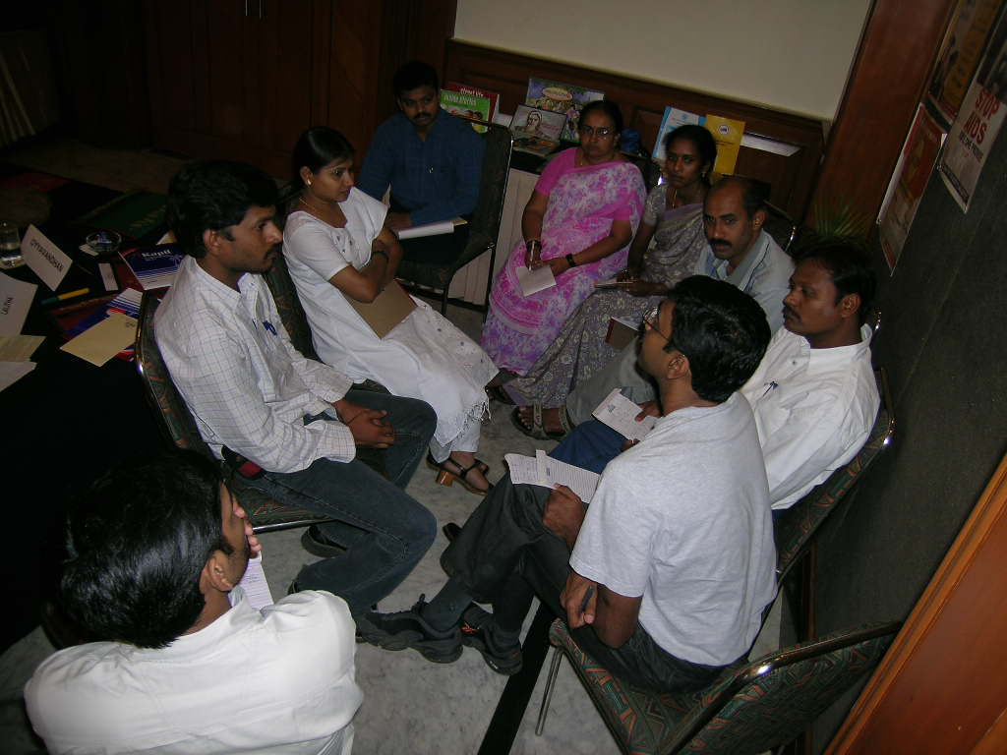
So, Let’s Do a Problem-Solving Exercise Together

Slide 14
Simulation Exercise: Data Use to Improve Quality of Care in Africa
A problem has been identified. What’s next?

Slide 15
Setting of This Exercise
Your team consists of regional health office managers checking on quality of care.
Problem:
  A recent measurement in Bofa Hospital, one of the district hospitals, indicated that only 55% of HIV+ clients, all of whom were expected to have a CD4 count done during the second half of 2009, had a CD4 result in their MR for a test done during that period.
Your team has been tasked with establishing the cause(s) of this problem.

Slide 16
Group Work
You have the full cooperation of the hospital director.
You can freely move around in the hospital.
You can speak to any staff you like.
Any documentation that you think may help you will be made available.

Slide 17
Group Work: Step 1
For this first step, answer the following question:
  Outline the design of the system to ensure that patients receive timely CD4 checks. Is the design appropriate?
  Drafting a flow chart may help you with this.
  What kind of documentation is available?

Slide 18
Team Presentations: Step 1
Provide an overview of the process.
Discuss any problems your team identified in the design of the system.
Briefly discuss the available documentation.

Slide 19
Flow Chart of the Process
MR
Patient eligible for CD4 count
Driver collects results at reg. lab
MR
Clinician orders CD4 count
Driver hands results to lab tech
Patient presents at lab
Lab tech enters results in CD4 reg.
CD4 Reg.
45% attrition in the system
CD4 Reg.
Lab tech enters pt in CD4 register
Lab tech hands results to data clerk
CD4 Reg.
Database
Lab tech takes sample
Data clerk enters results in database
Log book
Driver takes sample to reg. lab
Results handed to MR manager
MR manager files results in MR
MR

Slide 20
Analysis of the Process
How can we, in the fastest way possible, get a good sense of which points in the process cause the problem?

Slide 21
Keep Moving
Now that we know the two areas to concentrate on:
  Meet again with staff.
  Brainstorm ways to address each area.
  Try changes that you agree might be effective and can be implemented quickly.
  Limit the changes you implement at one time.
  Do a re-measure to assess your change.

Slide 22
Group Work: Step 2
Next, answer the following questions:
  Which are the cause(s) of the low performance on this indicator that your team has identified?
  If you have identified more than one cause, rank them in order of importance (i.e., the one that contributes most to the problem first).
  Make very brief recommendations for improvement.

Slide 23
Team Presentations: Step 2
Present the findings of your team.

Slide 24
Cross-Check Results:
MR Manager Is the Main Culprit!
Patient eligible for CD4 count
Driver collects results at reg. lab
MR
5%
Clinician orders CD4 count
Driver hands results to lab tech
CD4 Register
Patient presents at lab
Lab tech enters results in CD4 reg.
MR vs. CD4 Register
45% attrition in the system
Lab tech enters pt in CD4 register
Lab tech hands results to data clerk
CD4 Register
CD4 Register vs. Database
Lab tech takes sample
Data clerk enters results in database
Driver’s log
Driver takes sample to reg. lab
Results handed to MR manager
35%
MR vs. Database
5%
MR manager files results in MR

Slide 25
Cross-Check Results
Sources | Cross-check | Result
MR vs. MR | CD4 ordered if eligible? | 19/20
MR vs. CD4 register | Entered in CD4 register if CD4 ordered | 19/19
CD4 register vs. CD4 register | Sample taken if entered in CD4 register | 19/19 1200/1200
CD4 register vs. CD4 register | CD4 result entered if sample taken | 18/19 1140/1200
Database vs. CD4 register | CD4 result in database if result in CD4 register | 18/18 1140/1140
MR vs. database (or MR vs. CD4 register) | CD4 result in MR if entered in database (or CD4 register) | 11/18

Slide 26
Analysis of the Process
Each problem statement tells us something about the process designed to achieve an aspect of care.

Slide 27
ROUTINE HEALTH INFORMATION SYSTEMS
A Curriculum on Basic Concepts and Practice
This presentation was produced with the support of the United States Agency for International Development (USAID) under the terms of MEASURE Evaluation cooperative agreement AID-OAA-L-14-00004. MEASURE Evaluation is implemented by the Carolina Population Center, University of North Carolina at Chapel Hill in partnership with ICF International; John Snow, Inc.; Management Sciences for Health; Palladium; and Tulane University. The views expressed in this presentation do not necessarily reflect the views of USAID or the United States government.

